Slide 1
CHEM-E 101:
Introduction to UBC Chem-E-Car
UBC Chem-E-Car | Engineering Design Team The University of British Columbia, Vancouver
www.ubcchemecar.com
Notes:
Welcome everyone to the first info session for UBC Chem-E-Car. We are glad to have you all here today and thank you for taking time out of your schedules to come here. I will go over the projects that we do, what our expectations and requirements are of you, what you can expect to gain from us, and finally; what your potential role can be should you decide to join us.

Slide 2
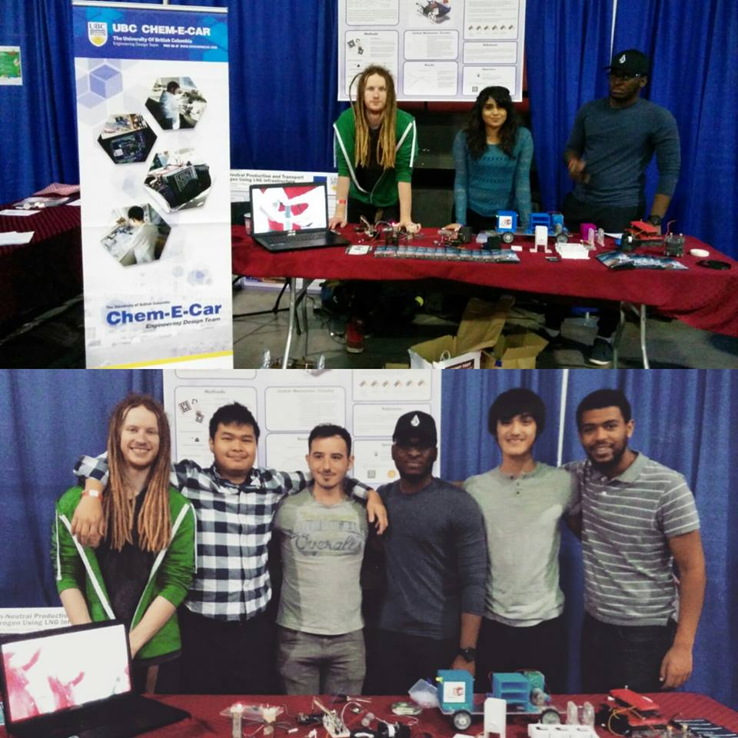
ABOUT US
Engineering Design Team, founded 2008 (only ~5-7 members per year until team expansion in 2015)
Projects focused on chemical engineering, emphasis on electrochemistry and energy
2016-2017 three main projects: Chem-E-Car, Zinc-Nickel Flow Cell, AIChE App Development (Potentiostat)
Very active in public outreach
Diverse and enthusiastic team
Notes:
First, I will go over a quick introduction of the team. We are one of the relatively newer design teams founded in 2008 and, are still in the progress of growing and developing our organization structure. Our home department is CHBE however, we draw from expertise from all fields and require all kinds of different skill sets for our projects. The projects themselves are divided into three groups: Chem-E-Car, which is a chemical powered model car. The Zinc-Nickel Flow Cell which, is a rechargeable battery system meant for integration with a solar micro-grid. And an engineering app development competition that we are engaging in this year for the first time ever. In addition to this we are also very active in public outreach and participate in numerous events to educate the public about alternative energy systems. Finally, we have a diverse team hailing from many different backgrounds giving us expertise in multiple fields

Slide 3
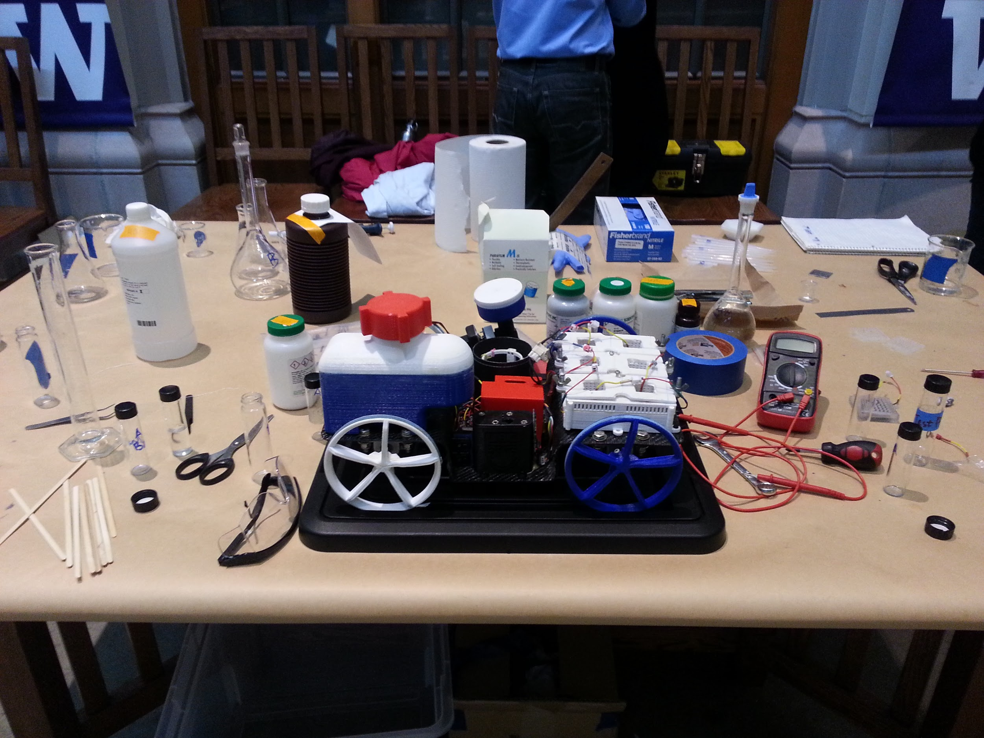
What’s a Chem-E-Car?
Main Team Project
Compete annually in AIChe Chem-E-Car Regional and National Competitions
Chemically powered and timed model vehicle

Slide 4
TEAM STRUCTURE
Team Captain
Team Leads
Admin Leads
Battery
Finance
Mechanical
Chemical
Electrical
Logistics
Communications
Sponsorship

Slide 5
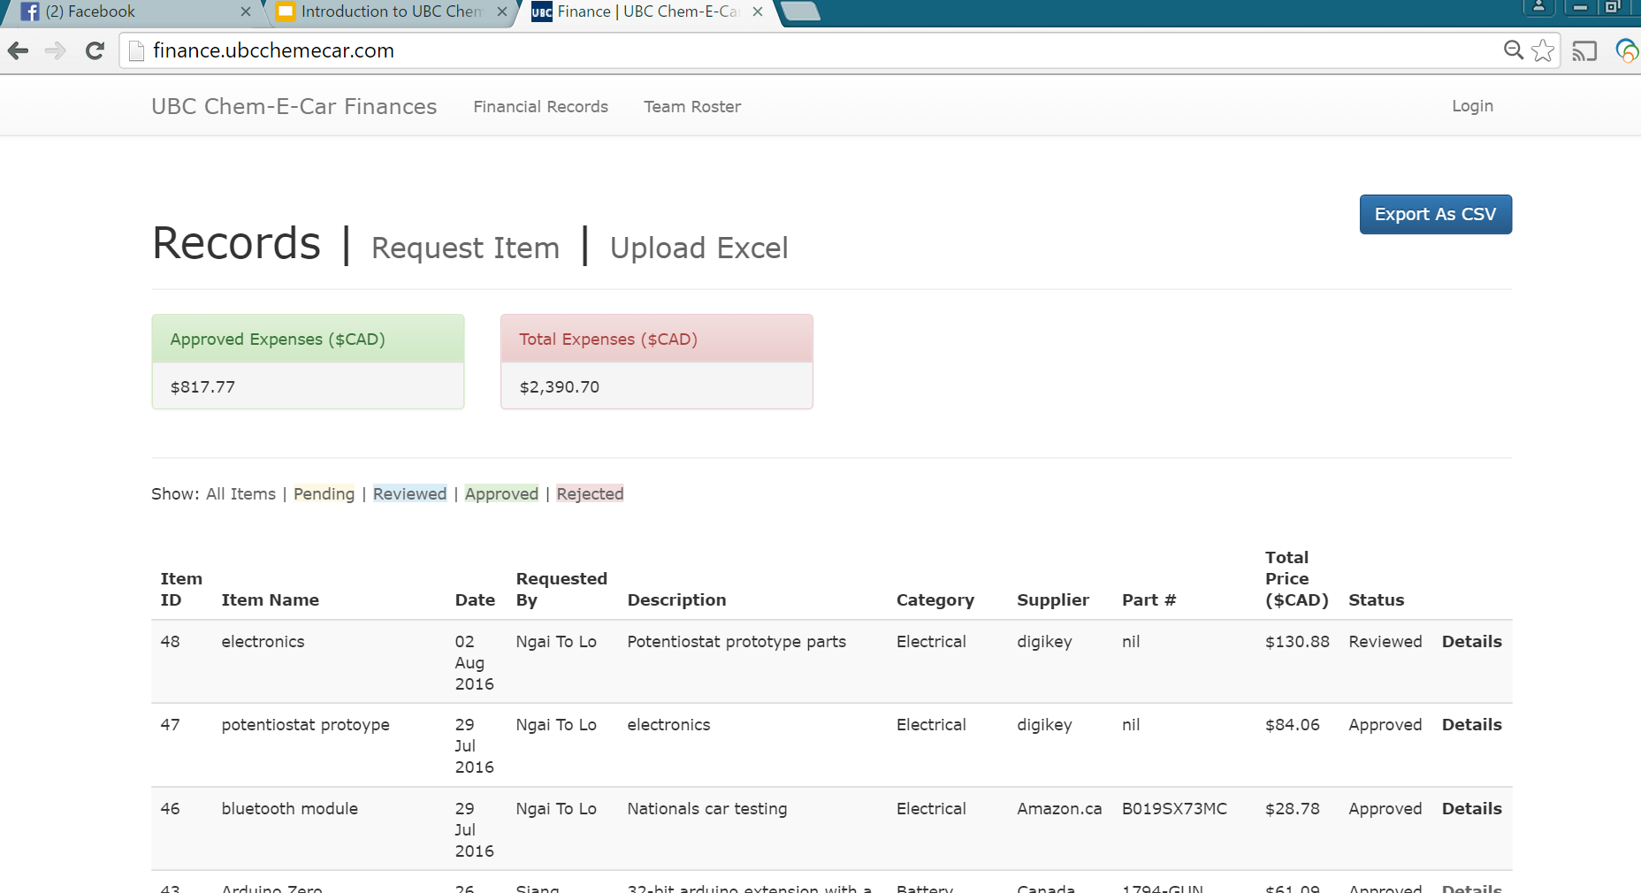
Administration team
Handles day-to-day operations for the team/project management
Manages funds and logistics
Responsible for sponsorship
Updates websites, social media
Communications and outreach
Skills you’ll learn:
Project management, fundraising and communications, software and web development

Slide 6
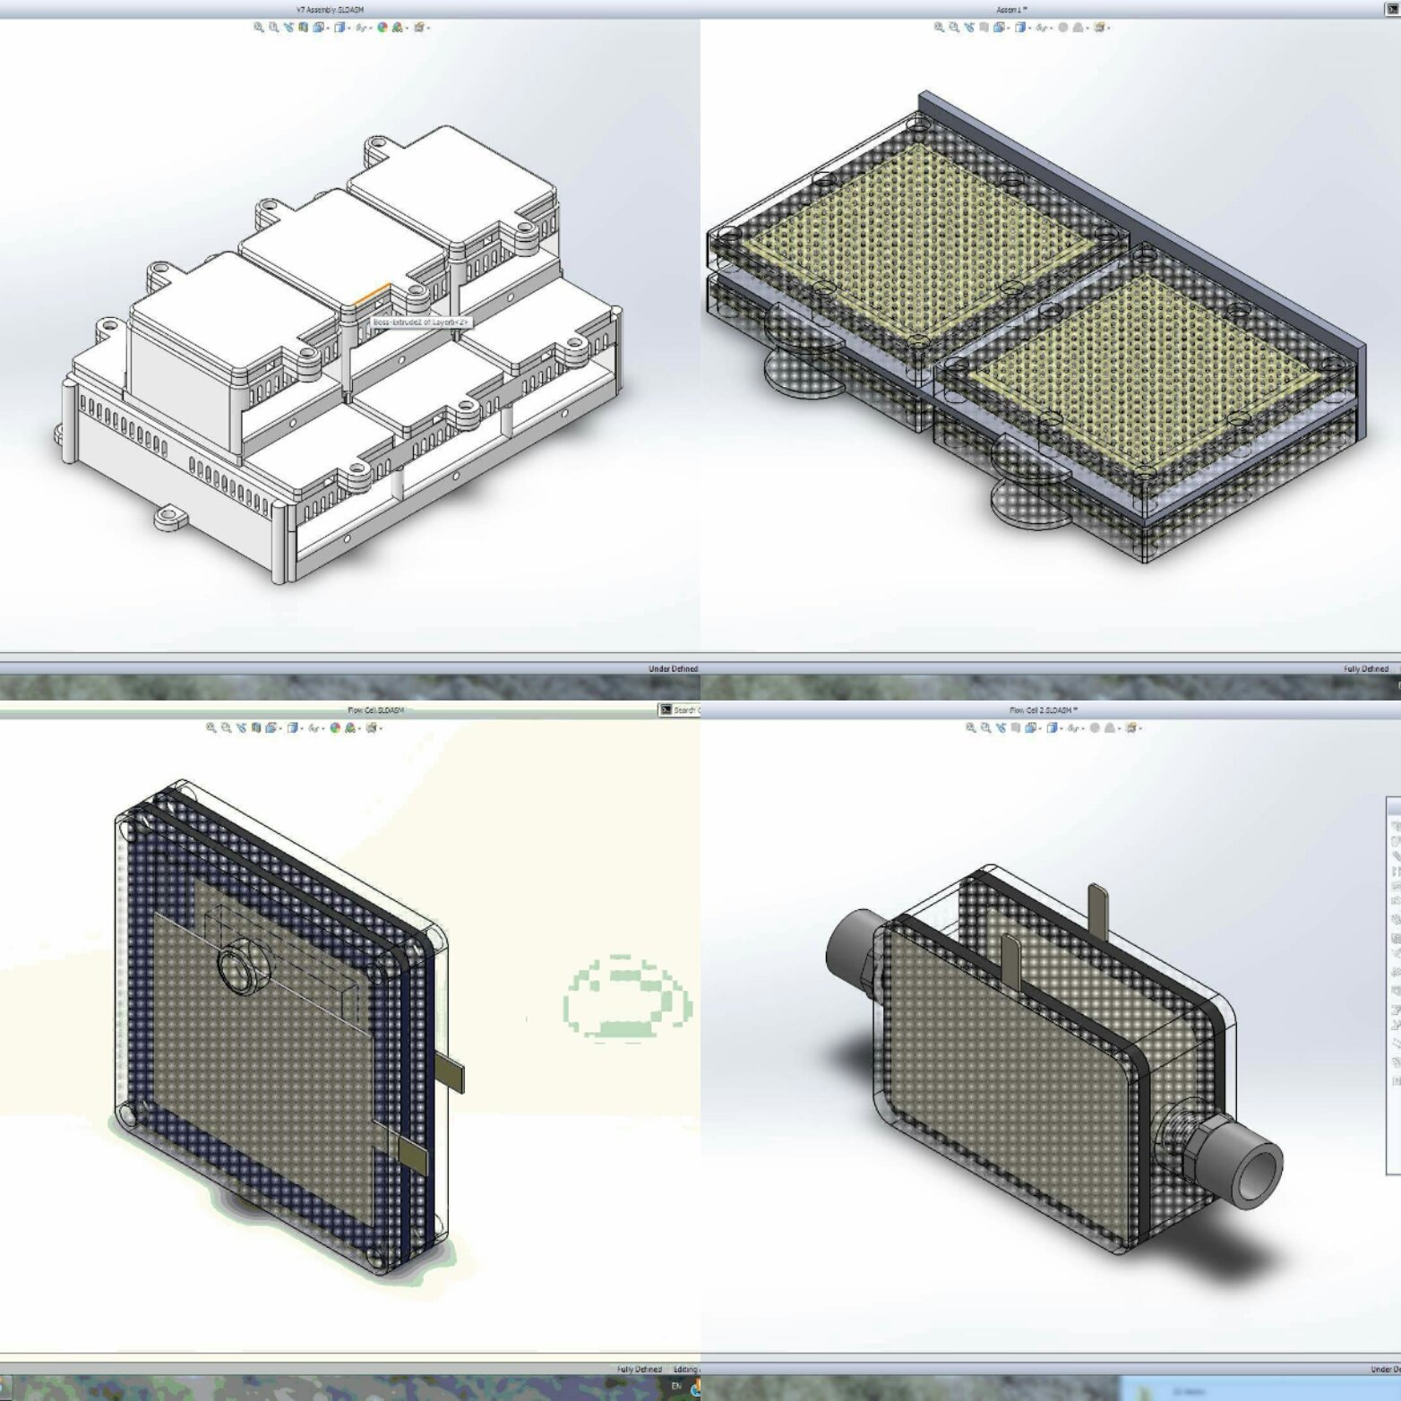
Battery
Develops and tests battery chemistry
Designs casing for battery systems in tandem with mechanical team
Skills you’ll learn:
Electrochemistry (very useful for battery/fuel cell co-ops i.e. AFCC, Ballard), drafting/CAD, research, experiment design

Slide 7
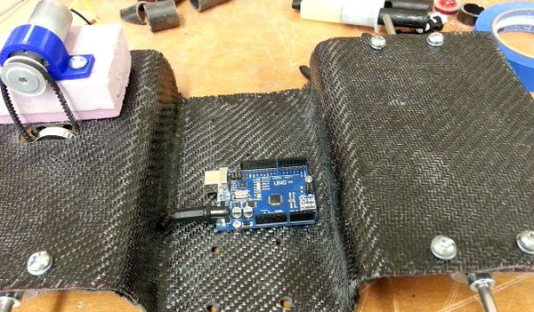
mechanical
Develops vehicle and all associated moving parts
Works with battery and chemical to develop respective casings
Skills you’ll learn:
Mechanical design, drafting/CAD, 3D printing, heavy machinery (CNC machine etc)

Slide 8
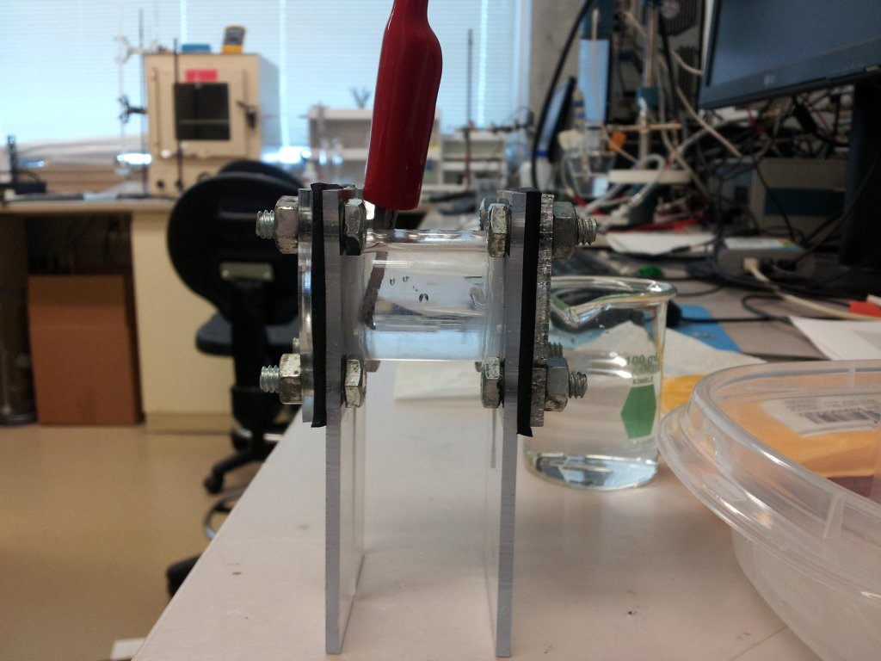
chemical
Develops chemical reaction for timing mechanism
Requires numerous tests to ensure optimum accuracy
Designs casing with integrated sensors with mechanical and electrical team
Skills you’ll learn:
Experiment design, wet lab skills, lab safety, literature review and research

Slide 9
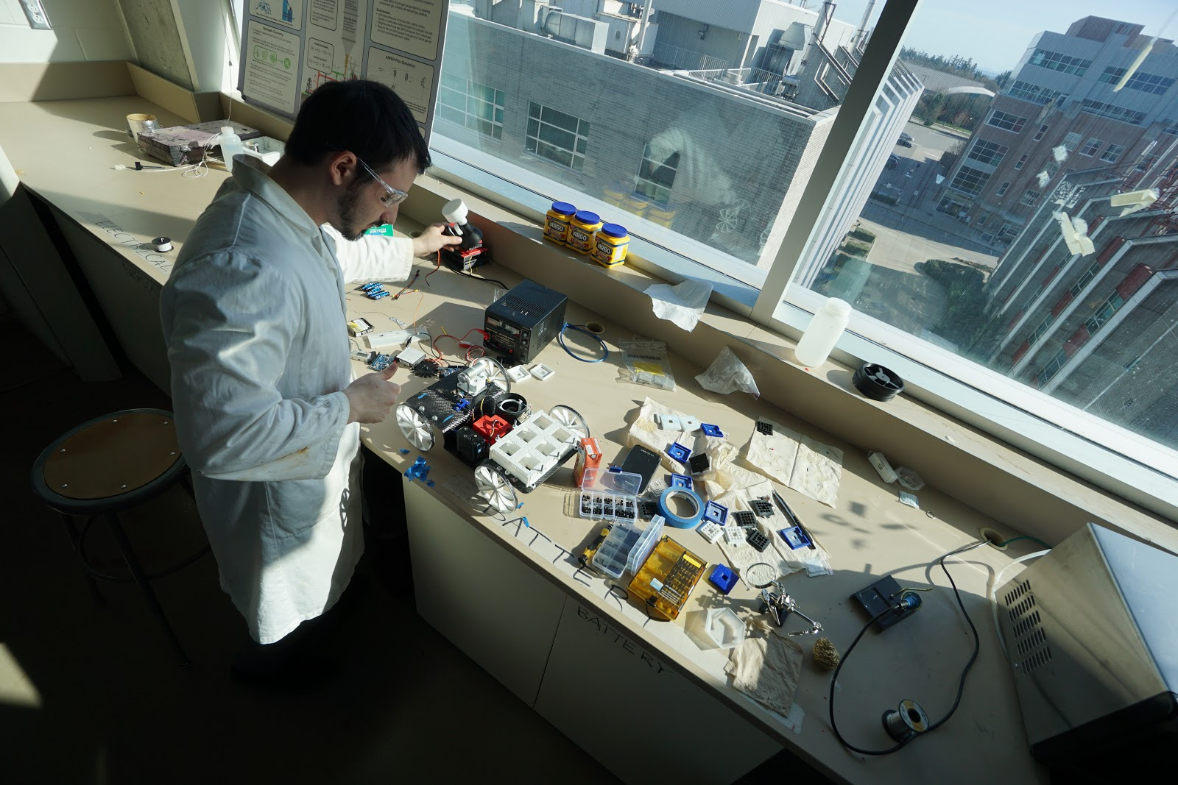
electrical
Builds electrical systems for starting/stopping car, and managing sensors / data collection
Creates software to run electrical systems and the vehicle
Skills you’ll learn:
Circuit design and analysis, Arduino, coding/programming

Slide 10
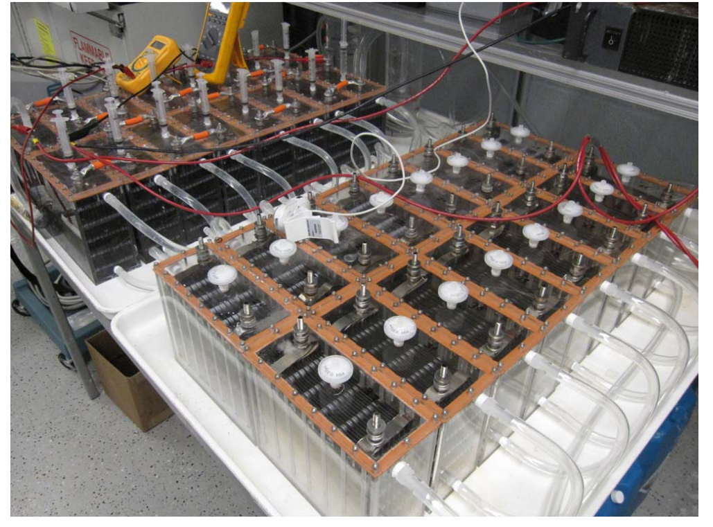
PROJECT #2: Zinc-Nickel Flow Cell
Experimental rechargeable battery system
Designed to hook up to Solar Powered Energy grid
Currently in Front End Design Phase
Arjun and Andy will speak more about this later
Figure Credits: City University of New York (CUNY)

Slide 11
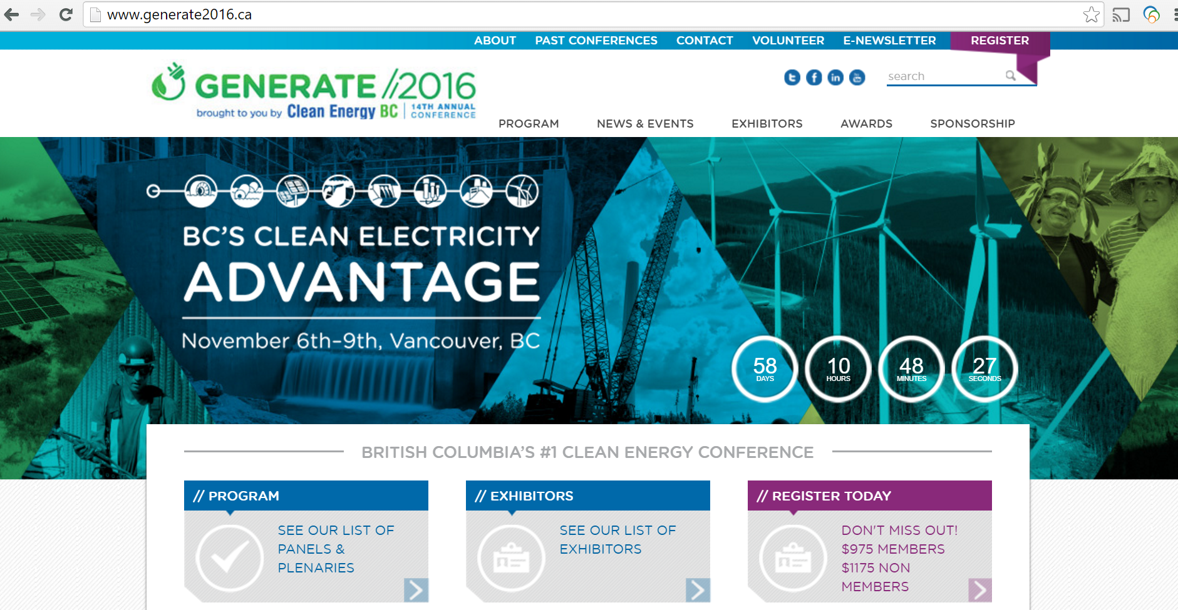
Generate 2016 conference
Student poster competition on energy-related projects
Why join?
Network with industry and future employers
Cash prizes and free conference ticket + good food
Potential co-op and internship offers (BC LNG competition)

Slide 12
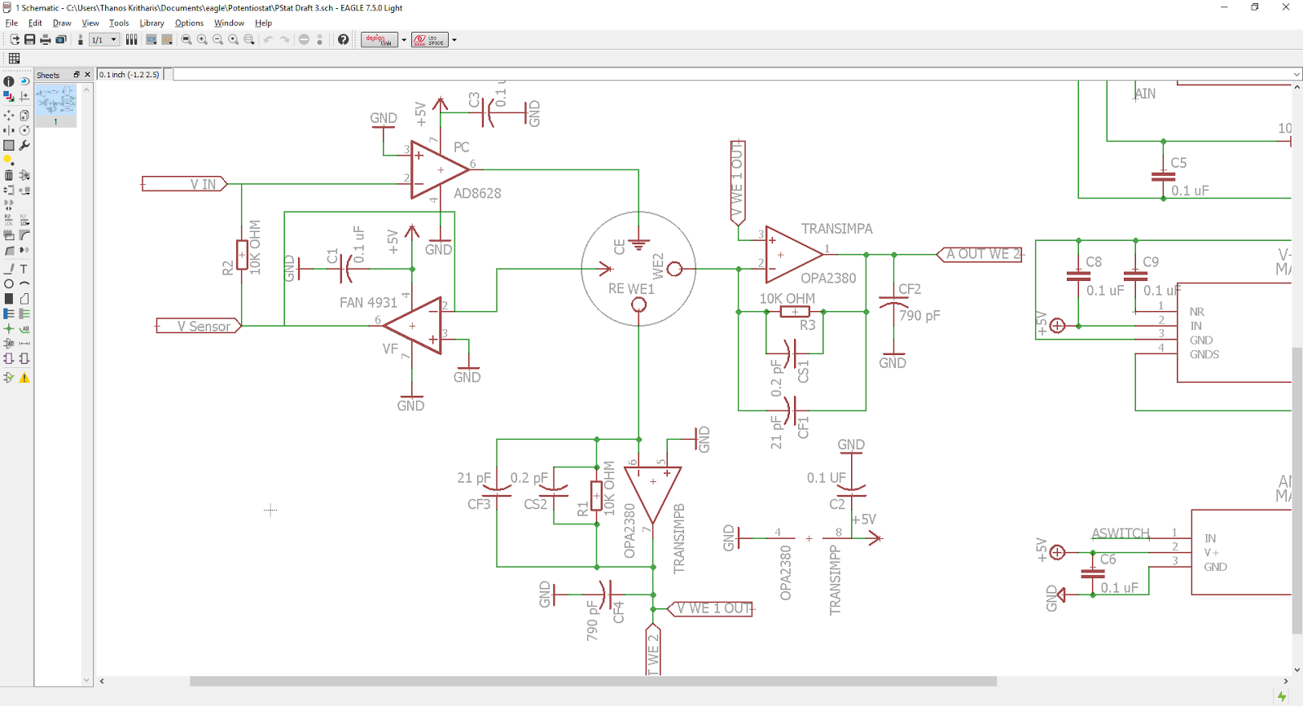
PROJECT #3: AIChE App project
Building a DIY potentiostat -hardware/software integrated project
Potentiostat: device for electroanalytical experiments
Used for investigating reaction mechanisms, catalyst activity, wastewater analysis etc

Slide 13
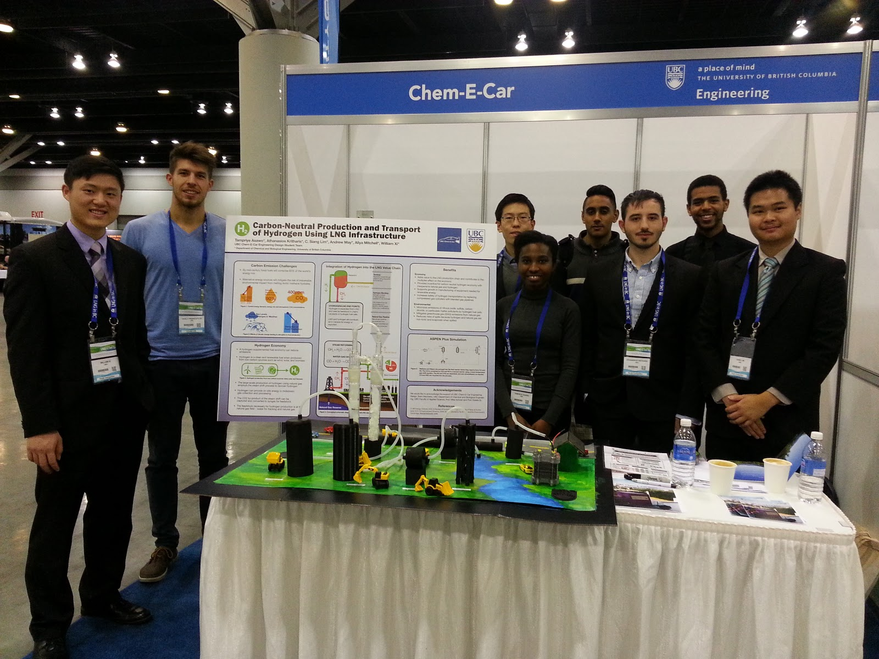
BENEFITS
Technical Skill development: machining, chemistry, CAD design, etc.
Professional Skill development: administration, leadership, teamwork, etc.
Formal safety training
Access and participation to professional development events
Exposure to professional engineering society through conferences and competitions

Slide 14
House rules
We want enthusiastic and self-motivated students that can work very independently under minimal supervision and instruction (good problem solving and research skills!).
At least 2 hours a week involvement in development, research, or administration. More during testing/construction period, less during exams.
Ultimately, what you get out of the team is what you put in. Opportunities and resources are always available. (At least $60k funding secured for next 3 years, $20k per year by our sponsorship team, strong CHBE department support).

Slide 15
REQUIREMENTs
Printed RMS safety certificate, Introduction to Chemical Safety, Chem-E-Car Safety certificate, RMS WHMIS certificate, and RMS Bullying and Harassment Links available on our website
Register as AIChE Student Member (free, sign up online) - bring proof of registration
Don’t forget to like us on Facebook and Instagram! (Important for sponsorship and funding purposes, DO IT RIGHT NOW: UBC CHEM-E-CAR, @UBCCHEMECAR)

Slide 16
Q/a session
Thank you!

